Slide 1
GOVERNMENT AYURVED COLLEGE & HOSPITAL, BARAMATI, PUNE
Teaching Staff

Slide 2
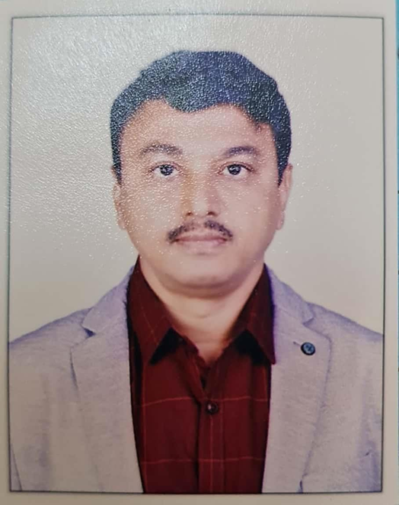
Name: Prof. Dr. Anil B. Kale
Designation: Dean
Department: Kaumarbhritya - Balrog
Teacher Code: AYKB00294
Qualification: M.D. ; Ph.D. (Kaumarbhritya - Balrog)
Experience: 25 years
Date of Birth: 26/12/1971
Registration No. : I-27506-A-1

Slide 3
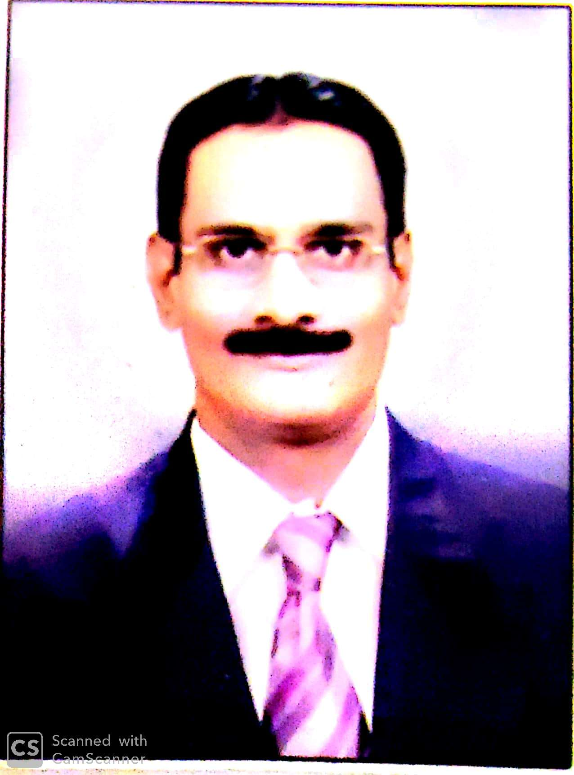
Name: Prof. Dr. Suryakant D. Rokade
Designation: Professor
Department: Rachana Sharir
Teacher Code: AYRS00717
Qualification: M.D. (Rachana Sharir) M.D. ( Kaychikitsa)
Ph.D. (Sharir Rachana)
Experience: 31 years
Date of Birth:11/12/1964
Registration No. : I-20073-A1

Slide 4
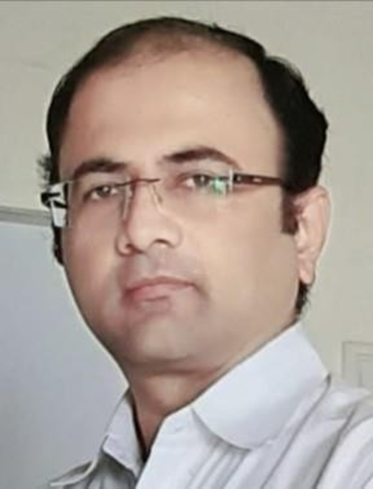
Name: Dr. Prashant G. Sali
Designation: Associate Professor
Department: Rachana Sharir
Teacher Code: AYRS00276
Qualification: M.D. ; Ph.D. (Rachana Sharir)
Experience: 21 YEARS
Date of Birth: 20/03/1977
Registration No.: I-36700-A-1

Slide 5
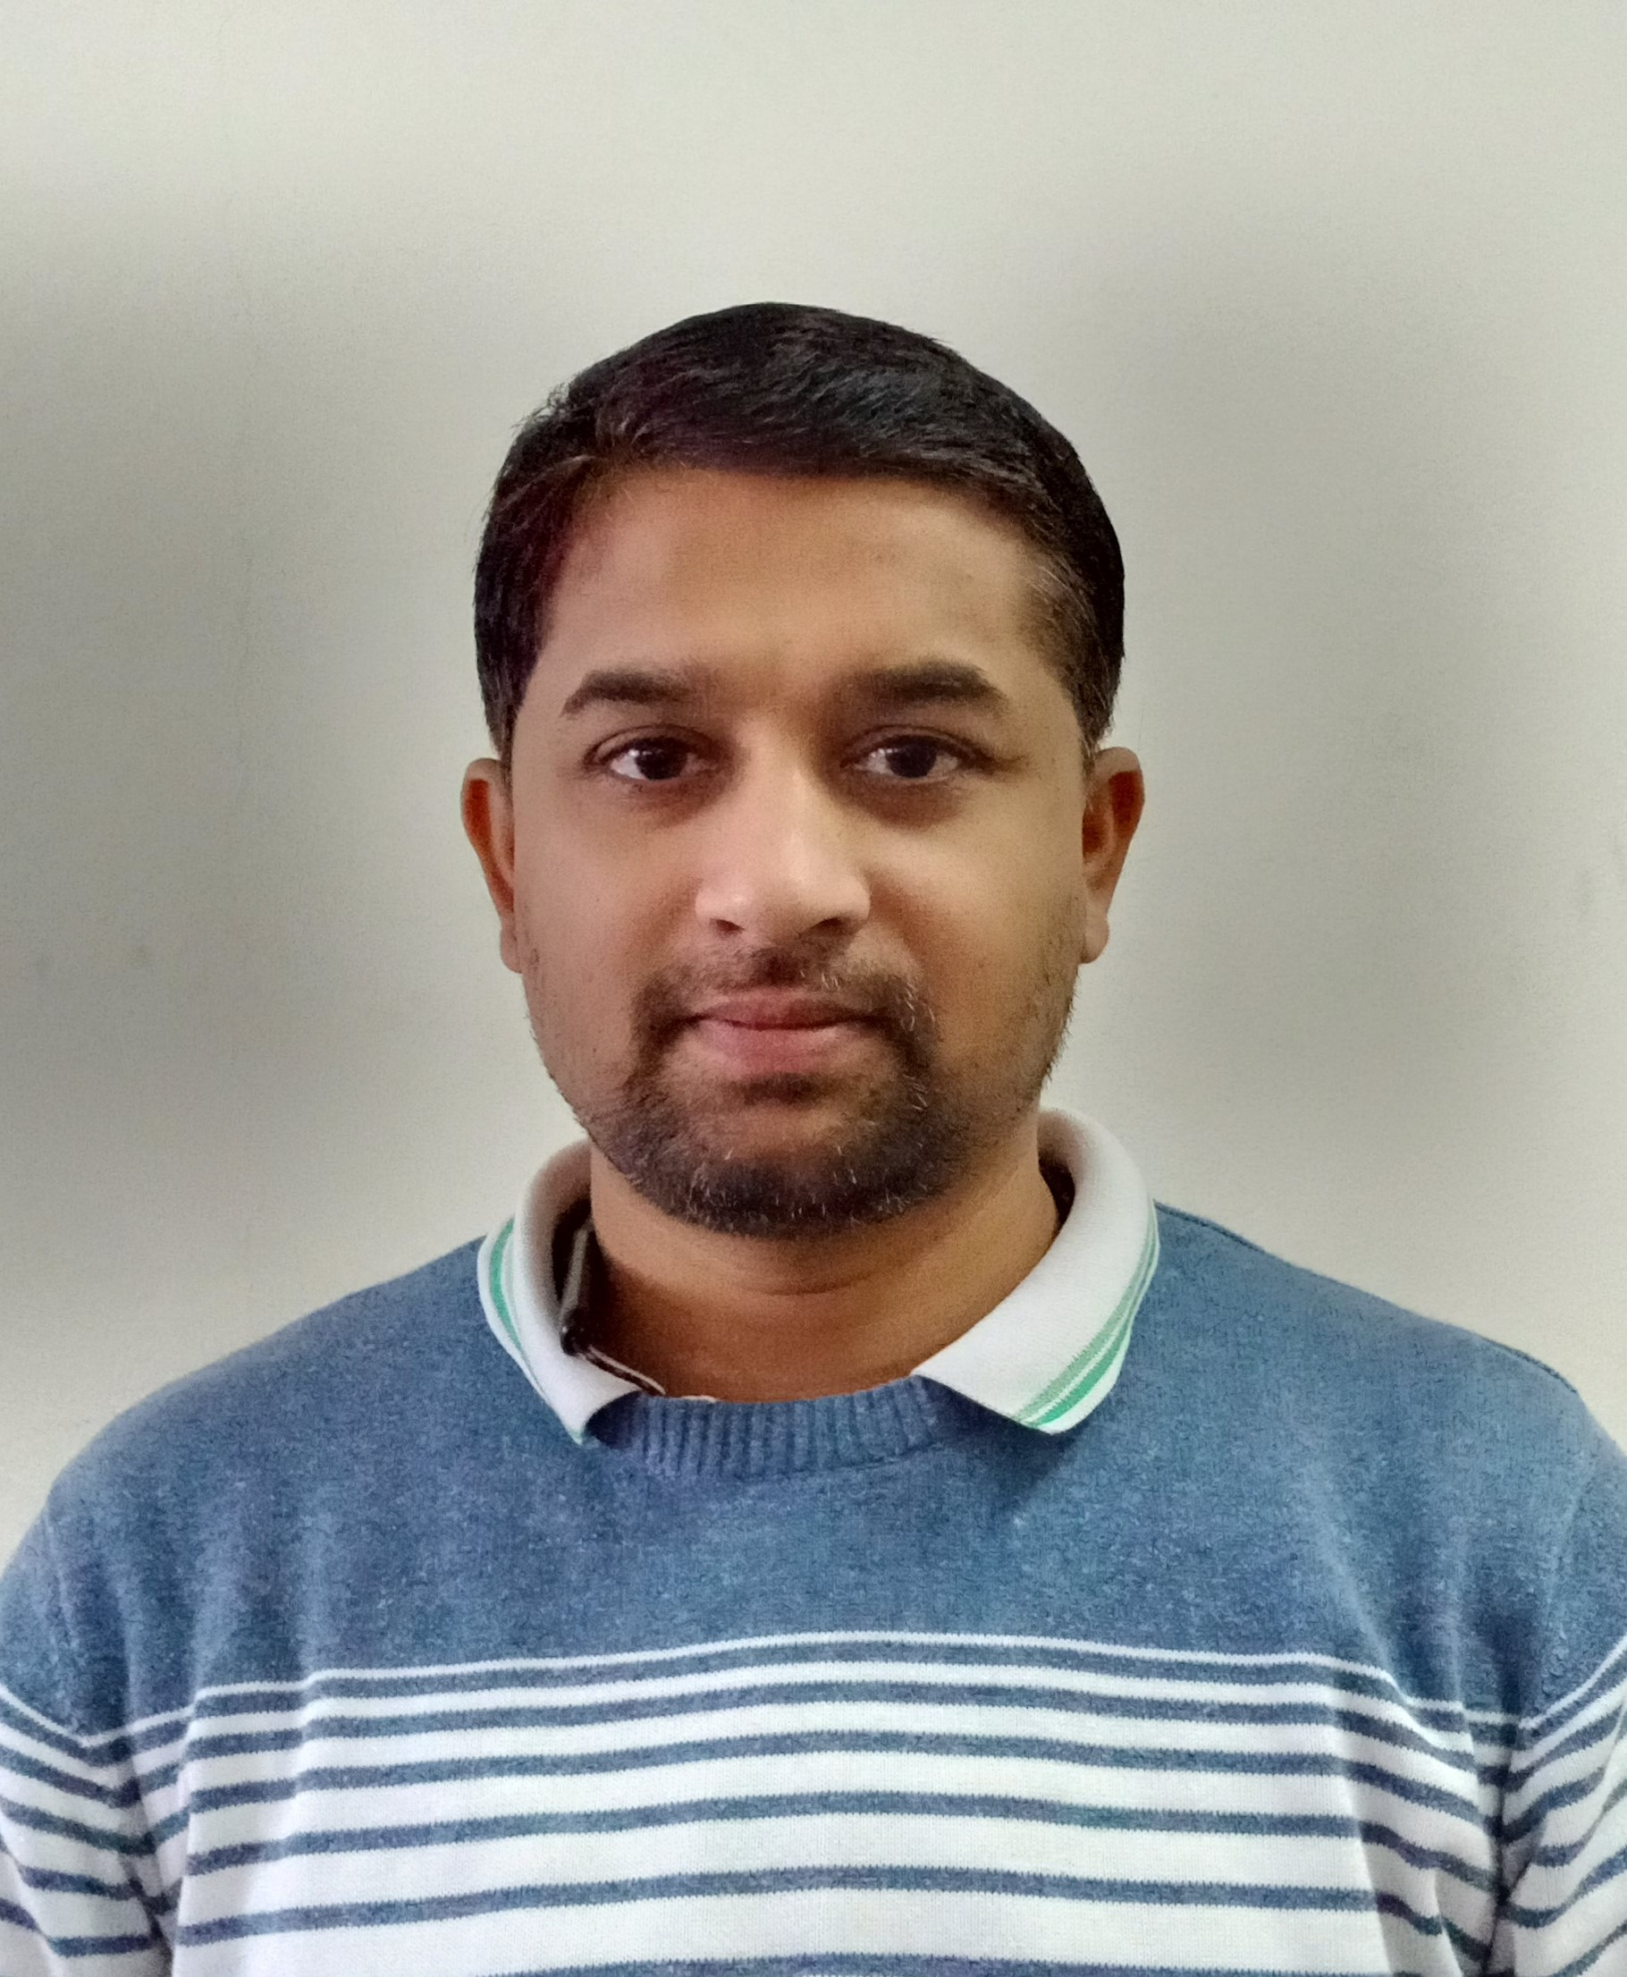
Name: Dr. Suraj S. Bhunje
Designation: Assistant Professor
Department: Rachana Sharir
Teacher Code: AYRS01425
Qualification: M.D. (Rachana Sharir)
Experience: 1 year
Date of Birth: 03/04/1987
Registration No.: I-68394-A

Slide 6
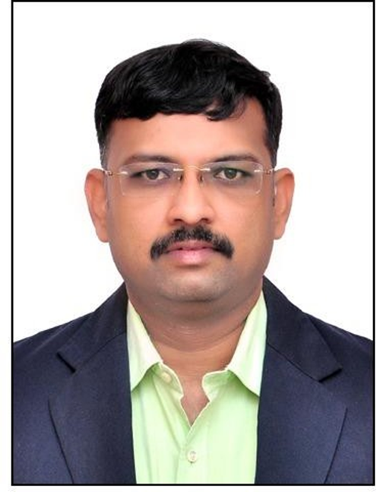
Name: Dr. Shrinivas S. Bobade
Designation: Assistant Professor
Department: Kriya Sharir
Teacher Code: AYKS00904
Qualification: M.D. (Kriya Sharir)
Experience: 3 years
Date of Birth: 21/02/1985
Registration No.: I-56948-A

Slide 7
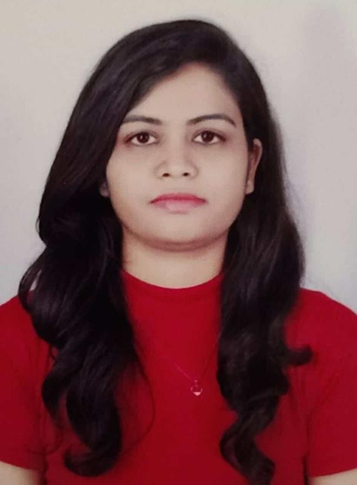
Name: Dr. Priyanka G. Kengale
Designation: Assistant Professor
Department: Sanskrit Samhita Siddhant
Teacher Code: AYSS01485
Qualification: M.D. (Samhita Siddhant)
Experience: 4 years
Date of Birth: 26/07/1993
Registration No.: I-85323-A

Slide 8
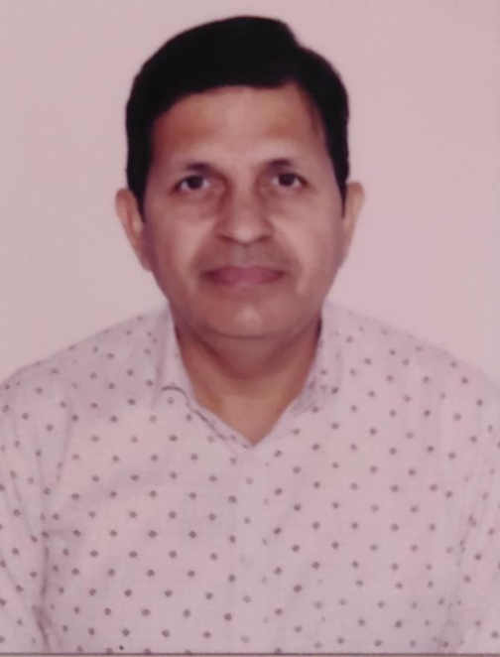
Name: Dr. Vijay T. Patil
Designation: Assistant Professor (Sanskrit)
Department: Sanskrit Samhita Siddhant
Teacher Code: AYSN00080
Qualification: M.A. (Sanskrit)
Experience: 16 years
Date of Birth: 05/06/1972
Registration No.: I-30056-A-1

Slide 9
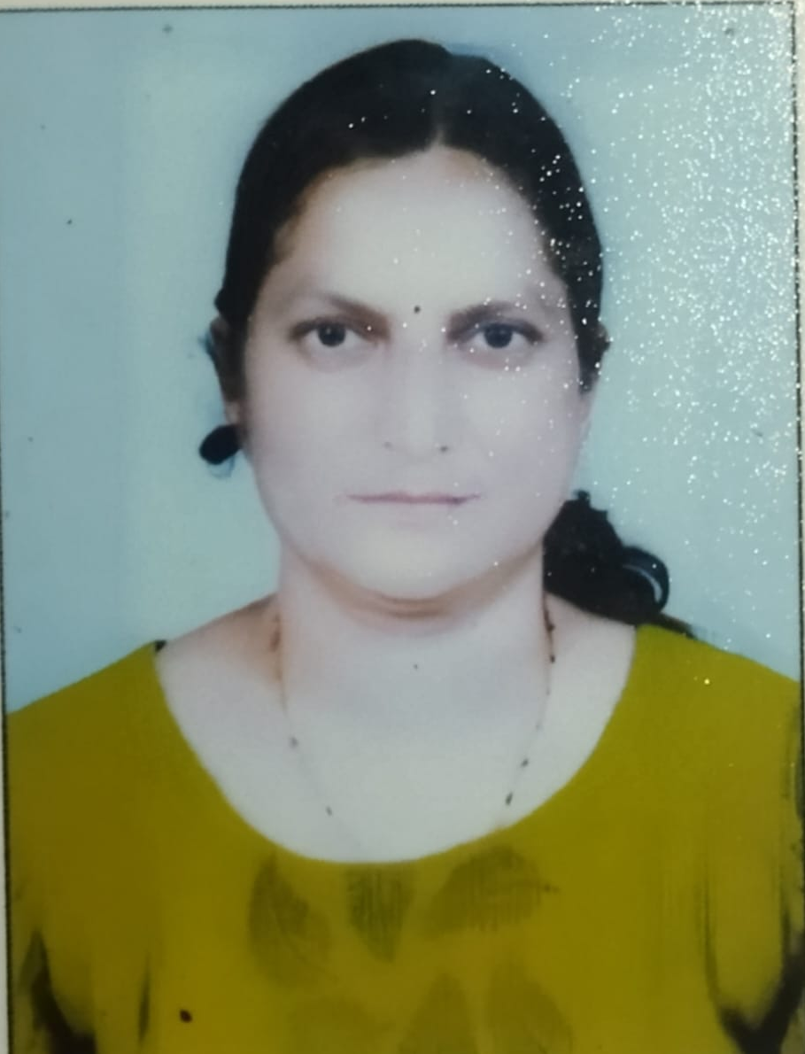
Name: Dr. Manisha A. Patil
Designation: Associate Professor
Department: Rasa Shastra evam Bhaishajya Kalpana
Teacher Code: AYRB00082
Qualification: M.D. (Rasa Shastra evam Bhaishajya Kalpana)
Experience: 6 years
Date of Birth: 01/01/1979
Registration No.: I-49360-A

Slide 10
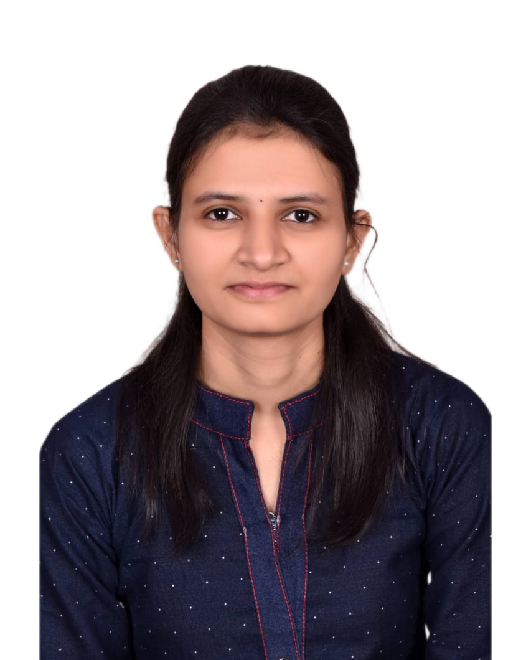
Name: Dr. Kalyani J. Shewalkar
Designation: Assistant Professor
Department: Rasa Shastra evam Bhaishajya Kalpana
Teacher Code: AYRB01994
Qualification: M.D. (Rasa Shastra evam Bhaishajya Kalpana)
Experience: 1 year
Date of Birth: 15/06/1992
Registration No.: I-85333-A

Slide 11
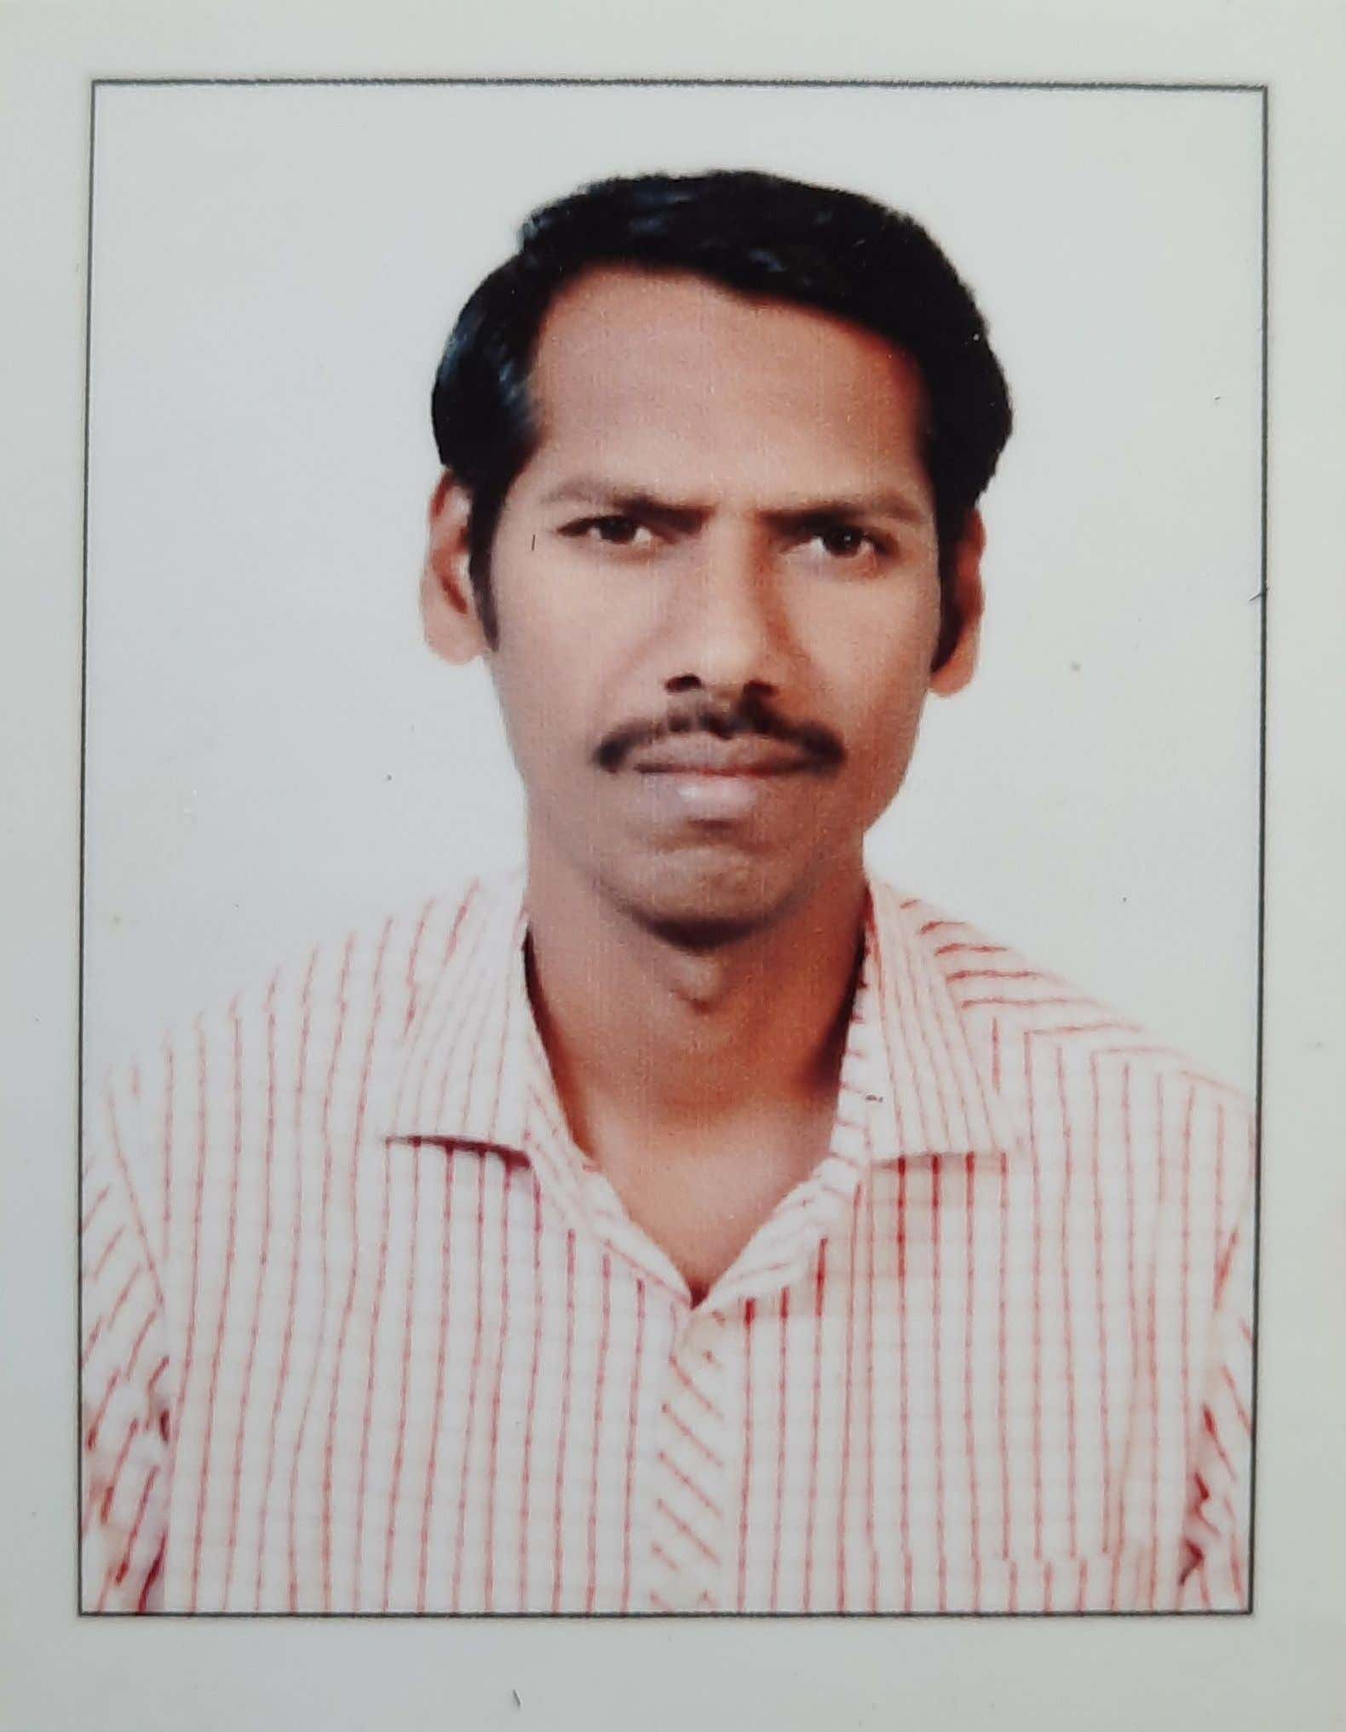
Name: Dr. Arvind C. Tumram
Designation: Associate Professor
Department: Agad Tantra
Teacher Code: AYAT00241
Qualification: M.D. (Agad Tantra)
Experience: 16 years
Date of Birth: 30/06/1976
Registration No.: I-44263-A-1

Slide 12
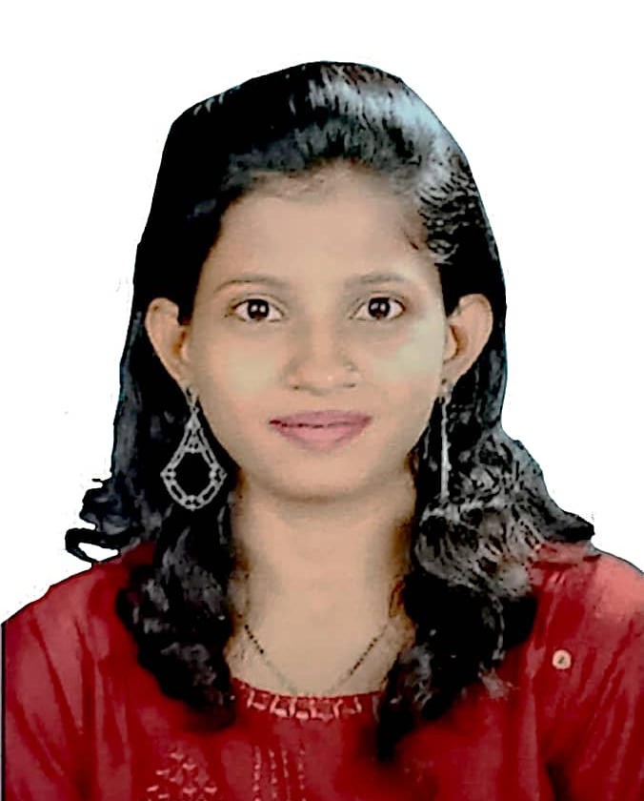
Name: Dr. Anjum M. Shaikh
Designation: Assistant Professor
Department: Agad Tantra
Teacher Code: AYAT00758
Qualification: M.D. (Agad Tantra)
Experience: 1 year
Date of Birth: 10/06/1994
Registration No.: I-91847-A

Slide 13
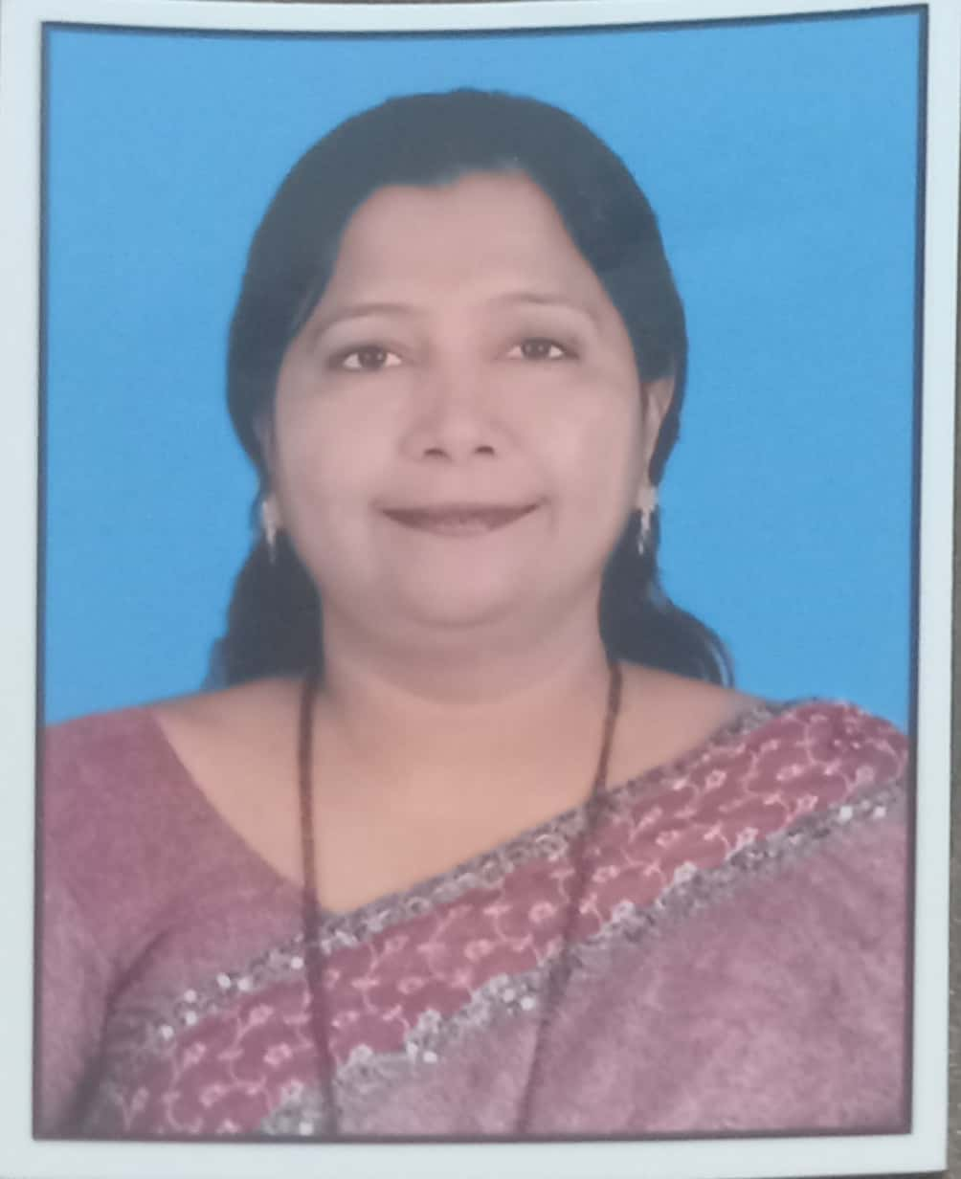
Name: Prof. Dr. Tabassum A. Pansare
Designation: Professor
Department: Dravyagun Vidnyan
Teacher Code: AYDG00841
Qualification: M.D. (Dravyagun)
Experience: 23 years
Date of Birth: 26/04/1975
Registration No.: I-32402-A-1

Slide 14
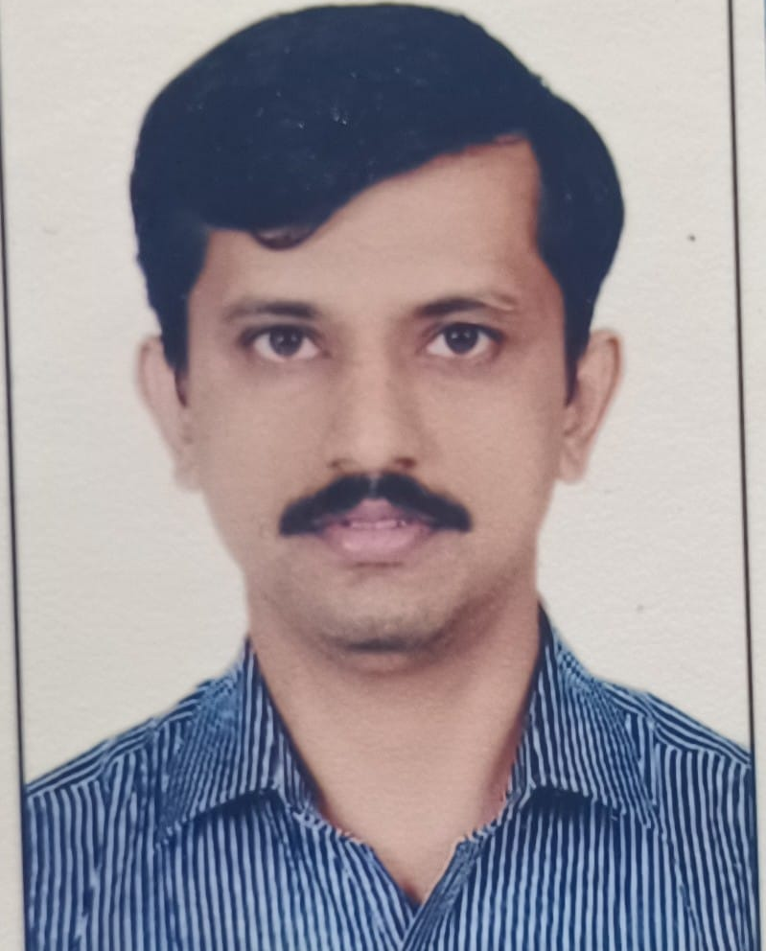
Name: Dr. Adarsha A Desai
Designation: Assistant Professor
Department: Dravyagun Vidnyan
Teacher Code: AYDG00841
Qualification: M.D. (Dravyagun)
Experience: 7 years
Date of Birth: 06/06/1982
Registration No.: I-48055-A

Slide 15
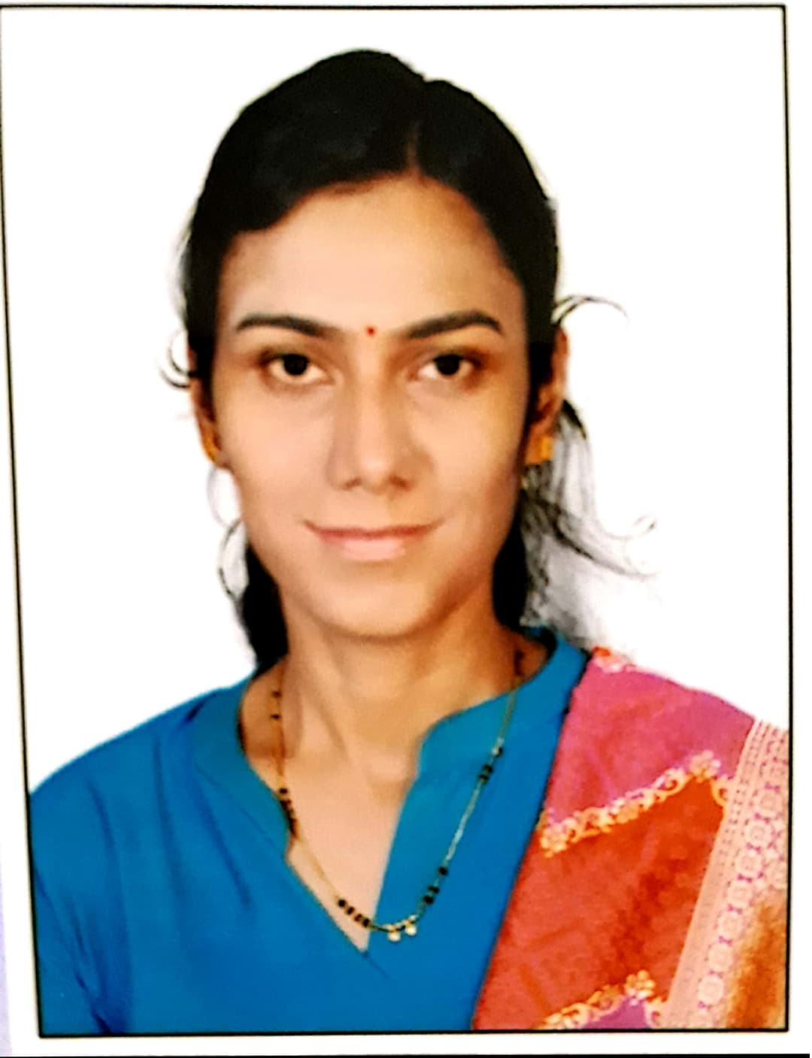
Name: Dr. Savita A. Wale
Designation: Associate Professor
Department: Rog Nidan evam Vikriti Vigyan
Teacher Code: AYRN00588
Qualification: M.D. (Rog Nidan evam Vikriti Vigyan)
Experience: 5 years
Date of Birth: 31/08/1988
Registration No.: I-70518-A

Slide 16
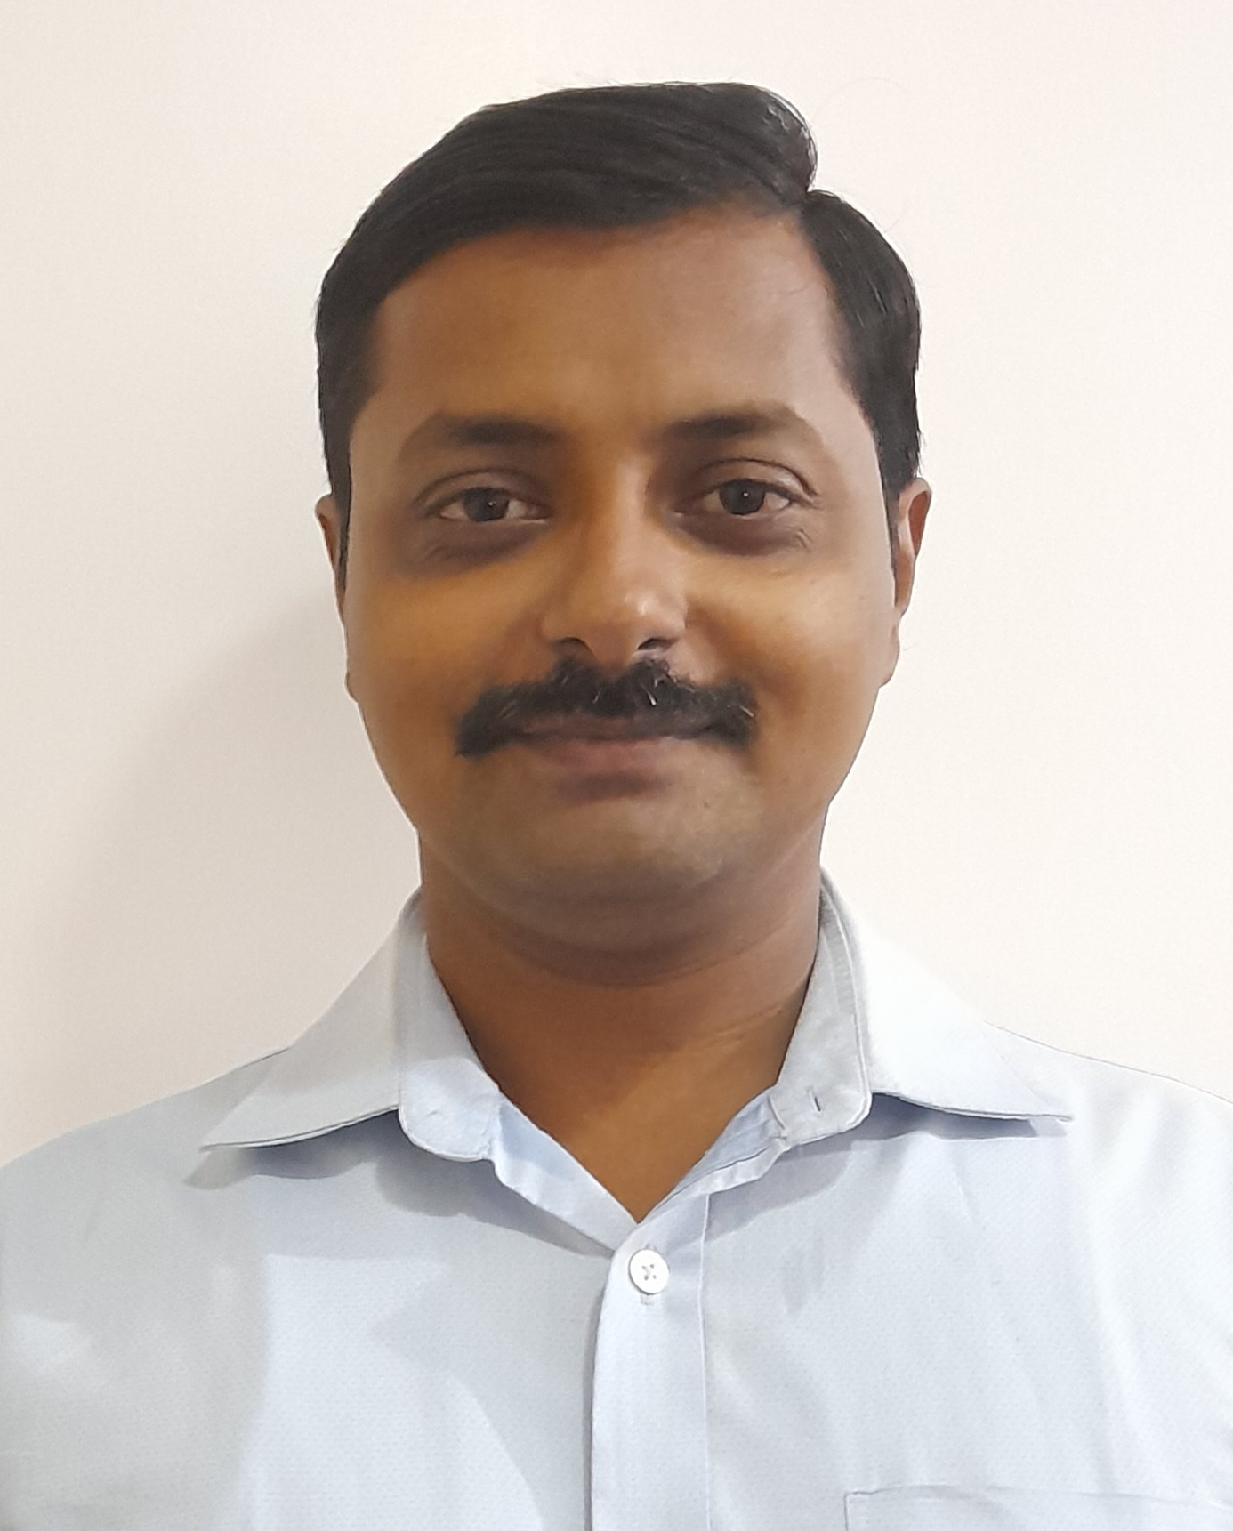
Name: Dr. Kshitij Y. Garge
Designation: Assistant Professor
Department: Rog Nidan evam Vikriti Vigyan
Teacher Code: AYRN00688
Qualification: M.D. (Rog Nidan evam Vikriti Vigyan)
Experience: 2 years
Date of Birth: 06/09/1986
Registration No.: I-67656-A

Slide 17
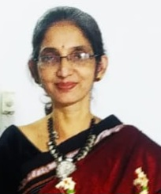
Name: Prof. Dr. Archana Inchekar
Designation: Professor
Department: Swastha Vritta
Teacher Code: AYSV00398
Qualification: M.D. (Swastha Vritta and Yoga)
Experience: 19 years
Date of Birth: 13/06/1973
Registration No.: I-31028-A-1

Slide 18
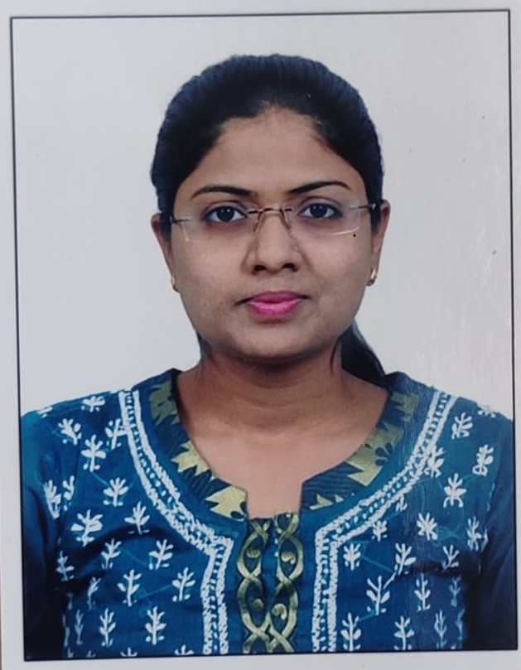
Name: Dr. Sarika A. Warhade
Designation: Assistant Professor
Department: Swastha Vritta
Teacher Code: AYSV00438
Qualification: M.D. (Swastha Vritta and Yoga)
Experience: 2.5 years
Date of Birth: 20/10/1990
Registration No.: I-79462-A

Slide 19
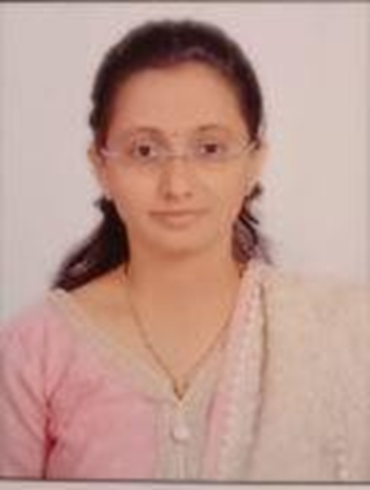
Name: Dr. Bhakti A. Pawar
Designation: Yoga Teacher
Department: Swasthyavritta and Yoga
Qualification: M.A. (Yoga)
Experience: 2.5 years
Date of Birth: 01/05/1983
Registration No.: I-55222-A

Slide 20
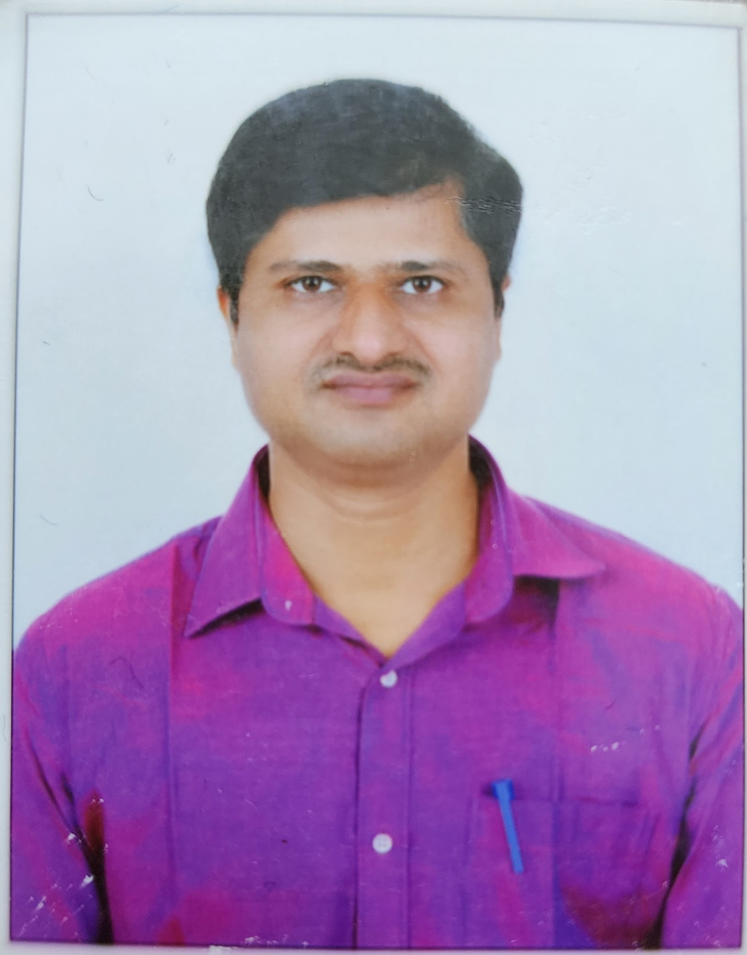
Name: Dr Chetan Krishna Shingane
Designation: Assistant Professor
Department: Kayachiktsa
Teacher Code: AYKC02761
Qualification: M.D. (Kayachiktsa)
Experience: 11 years
Date of Birth: 08/05/1981
Registration No.: I-45176-A

Slide 21
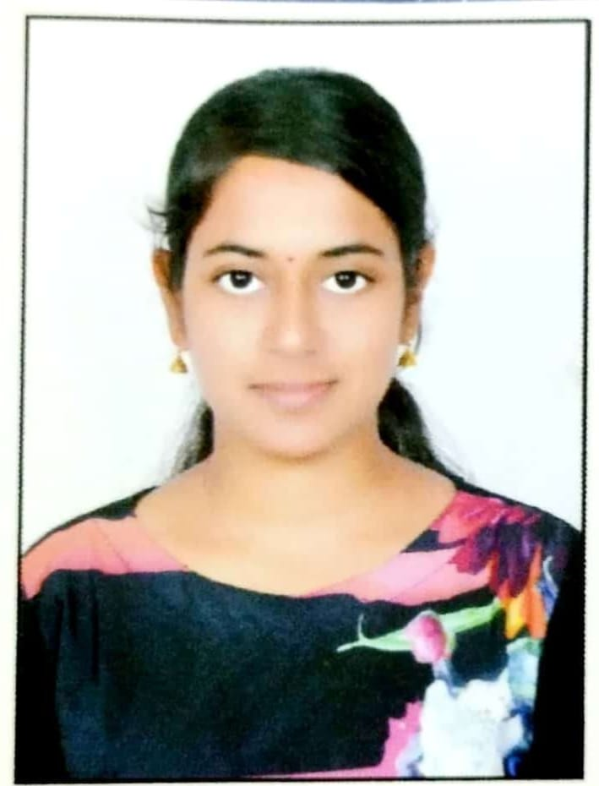
Name: Dr. Smita M. Patil
Designation: Assistant Professor
Teacher Code: AYPS01556
Department: Prasutitantra and Strirog
Qualification: MD (Prasutitantra and Strirog)
Experience: 1 year
Date of Birth: 02/04/1994
Registration No.: I-104805-E

Slide 22
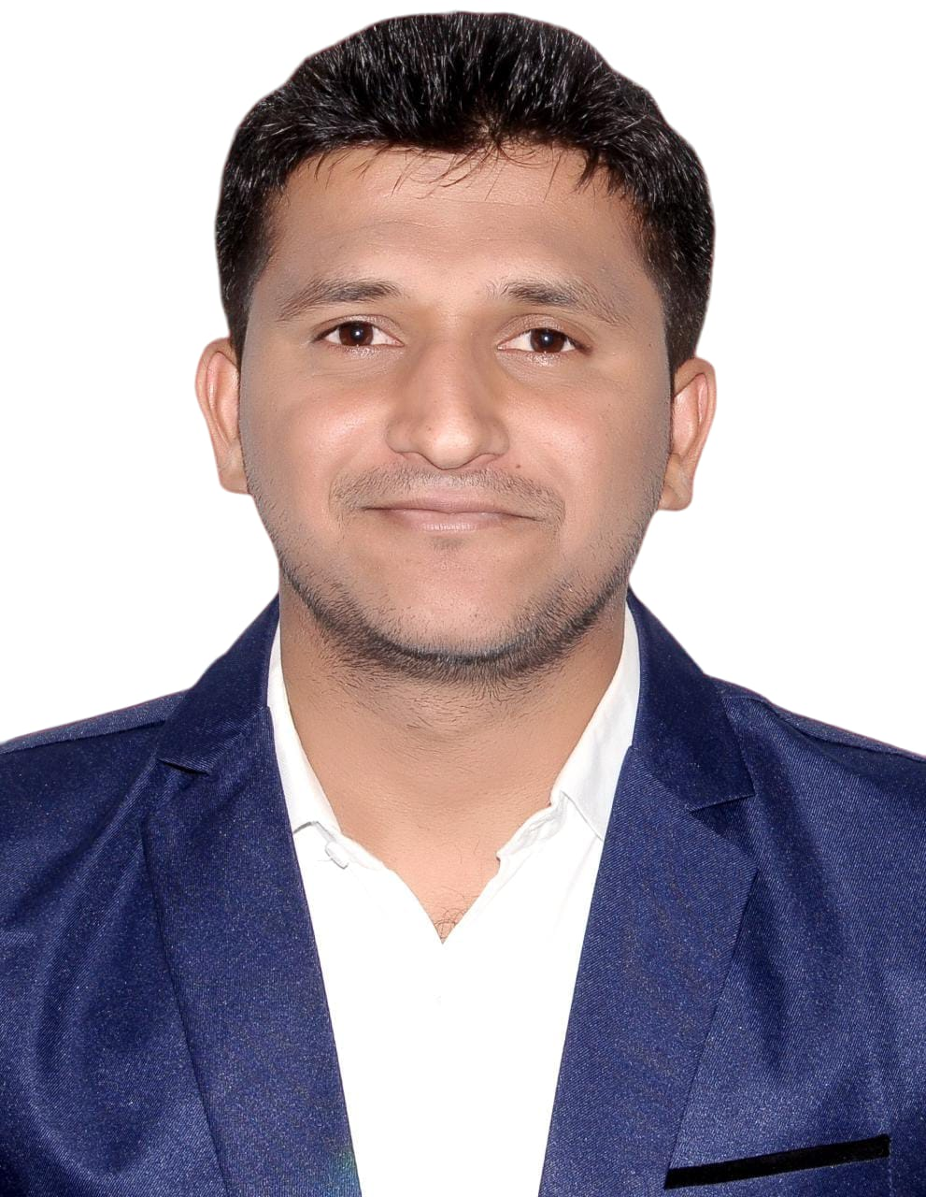
Name: Dr. Somnath G. Wadkar
Designation: Assistant Professor
Teacher Code: AYST0002434
Department: Shalyatantra
Qualification: MS (Shalyatantra)
Experience: 1 year
Date of Birth: 12/12/1994
Registration No.: I-91071-A

Slide 23
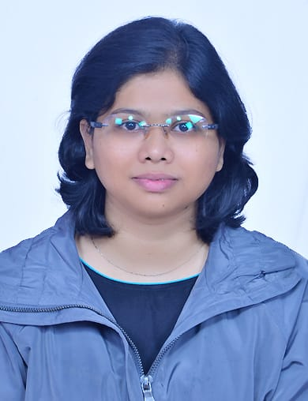
Name: Dr. Anjum M. Metkari
Designation: Assistant Professor
Teacher Code: AYSK01246
Department: Shalakyatantra
Qualification: MD (Shalakyatantra)
Experience: 1 year
Date of Birth: 10/04/1993
Registration No.: I-84935-A

Slide 24
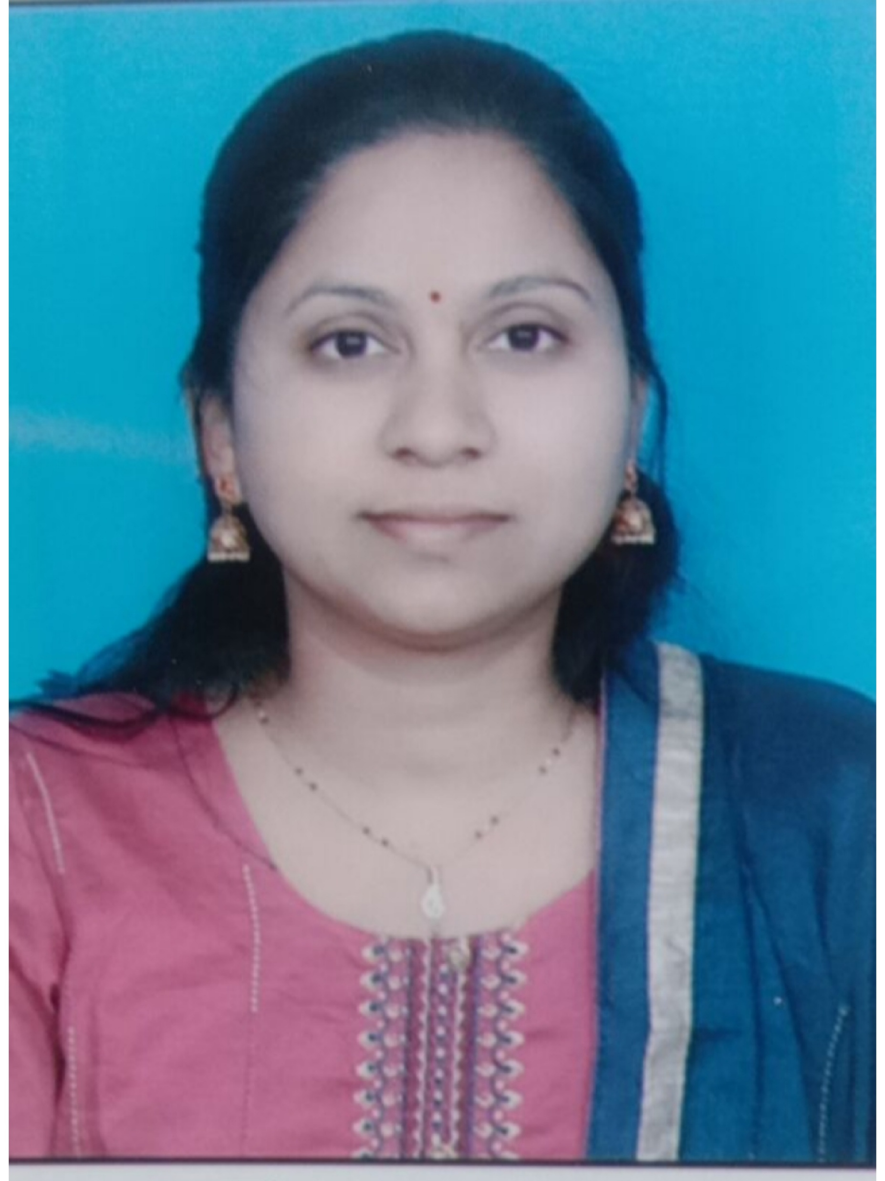
Name: Dr. Jaya P. Maske
Designation: Assistant Professor
Teacher Code: AYPK01274
Department: Panchakarma
Qualification: MD (Panchakarma)
Experience: 2 years
Date of Birth: 21/12/1987
Registration No.: I-71217-A

Slide 25
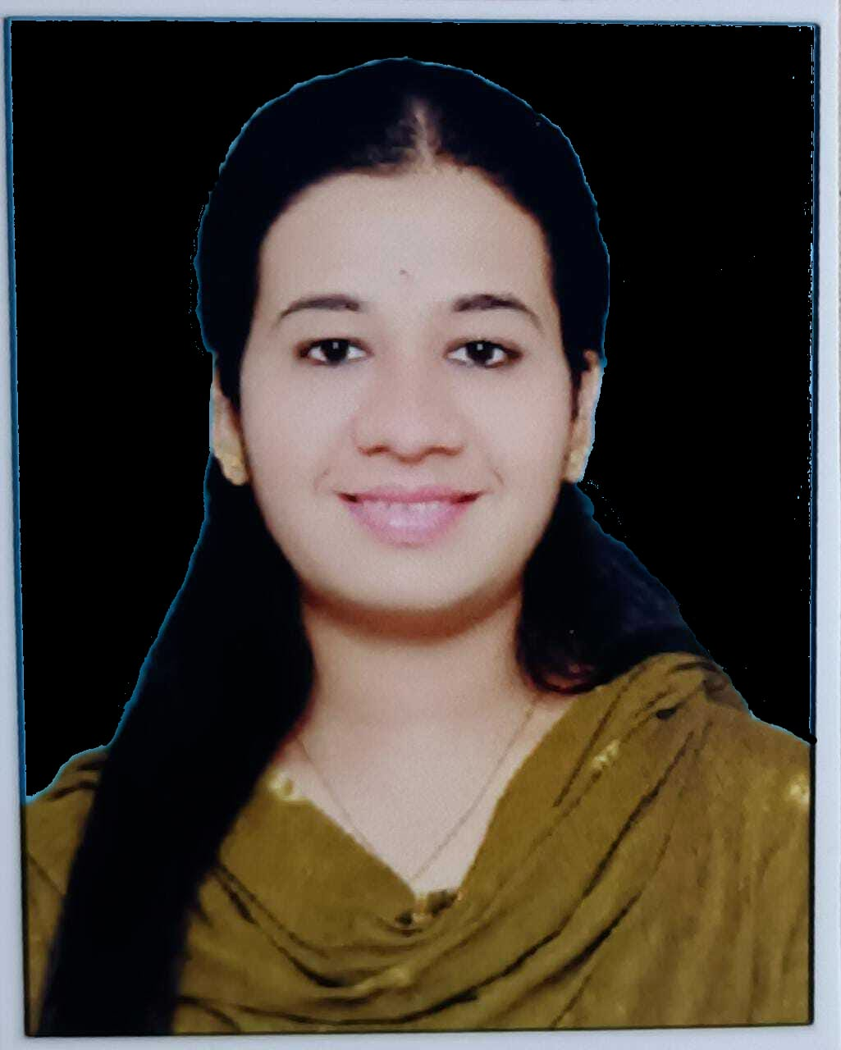
Name: Dr. Sujata J. Khuspe
Designation: Assistant Professor
Department: Kaumarbhrutya
Qualification: MD (Kaumarbhrutya )
Experience: 3 Months
Date of Birth: 13/05/1993
Registration No.: I-85624-A

